Slide 1
Angular CLI
Generating Routing Features
Lecture 5
By James(Jin) Wang
09/28/2019

Slide 2
Outline
Adding routing features
Considerations before generating a module
Routing paths to components
Generating guards

Slide 3
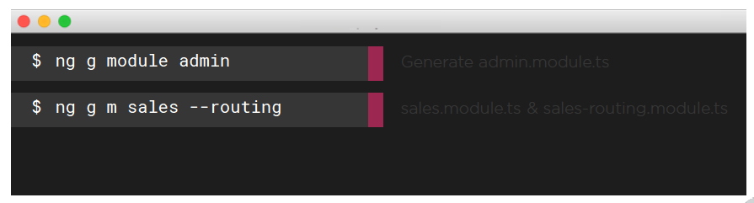
The NgModule Blueprint with Routing
  NgModules and Routing:
  Generate a new NgModule with ng g module <name> <options>
  Define a module and a separate routing module with --routing

Slide 4
Demo
  ng new angular-routing --routing
  ng serve -o
  generate Components:
  ng g c dashboard -d
  ng g c customer -d
  const routes: Routes = [
  { path: '', pathMatch: 'full', redirectTo: 'dashboard' },
  { path: 'dashboard', component: DashboardComponent },
  { path: 'customer', component: CustomerComponent }
  ];

Slide 5
Demo
  <nav>
  <ul>
  <li><a href="" [routerLink]="['/dashboard']">Dashboard</a></li>
  <li><a href="" [routerLink]="['/customer']">Customer</a></li>
  </ul>
  </nav>

Slide 6
Demo
  generate Modules:
  ng g m admin --routing -m app.module
  ng g c admin -d
  ng g c admin/email-blast -d
  ng g c admin/users -d

Slide 7
Demo
  const routes: Routes = [
  {
  path: 'admin',
  component: AdminComponent,
  children: [
  { path: '', component: UsersComponent },
  { path: 'blast', component: EmailBlastComponent },
  ]
  }
  ];

Slide 8
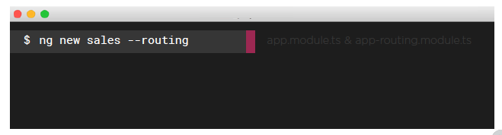
The NgModule Blueprint with Routing
  Generating an App with Routing Features:
  Generate a new NgModule with ng new <app-name> <options>
  Define a separate routing module for the new app with --routing

Slide 9
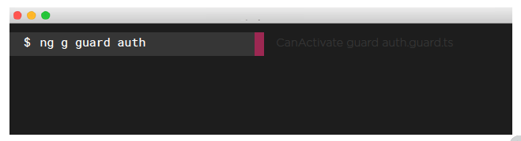
Guards
  Guards:
  Generate a guard for routes
  ng g guard <name>

Slide 10
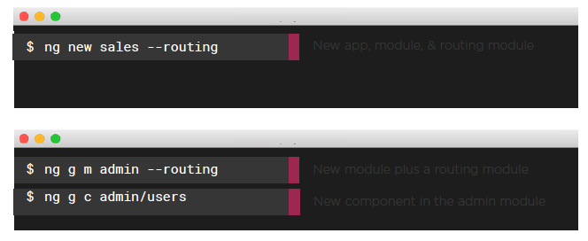
Guards
  Adding Routing Features with the Angular CLI:

Slide 11
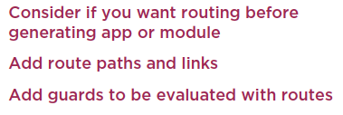
Summary

